Slide 1

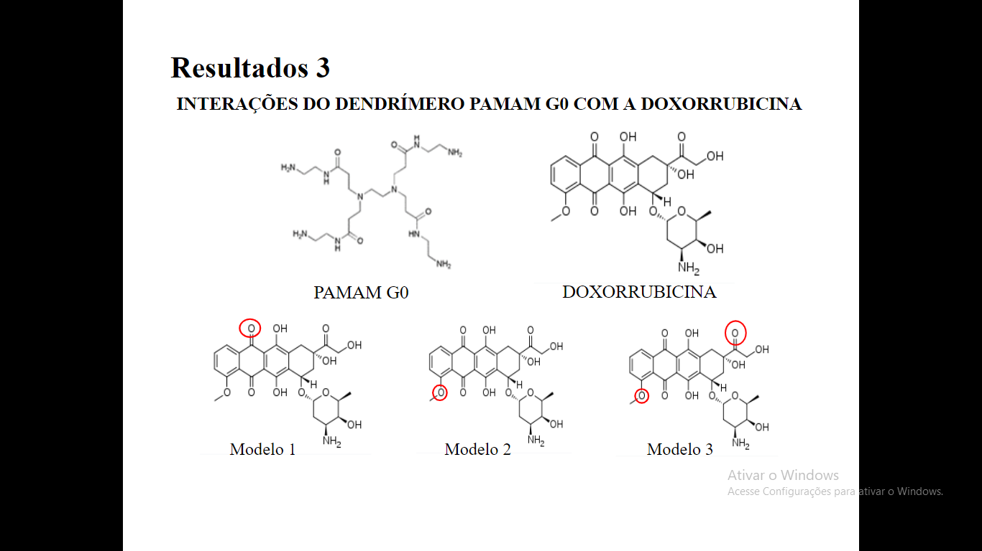
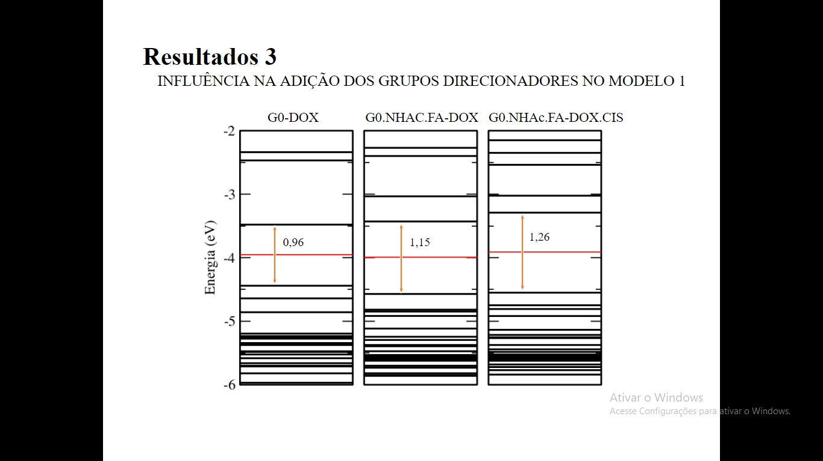
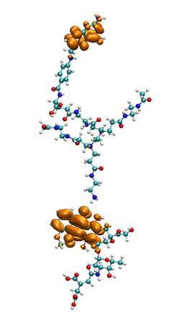
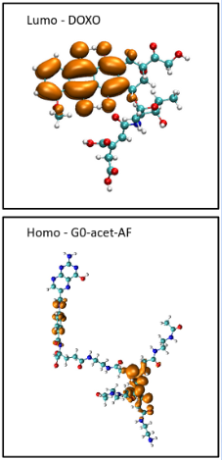
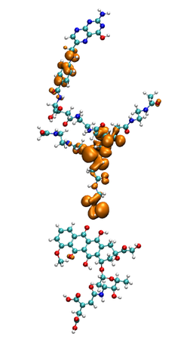
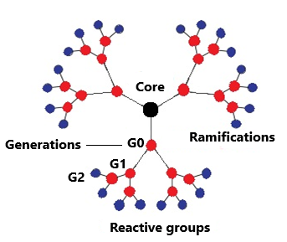
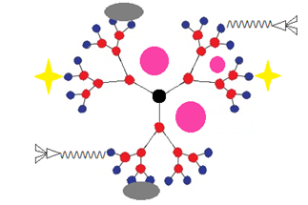
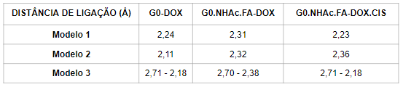
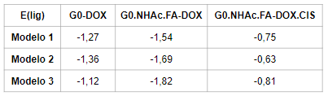
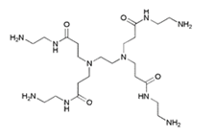
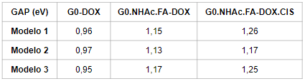
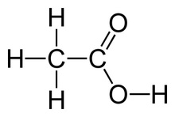
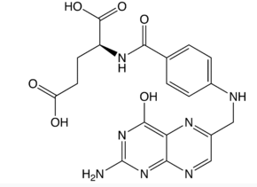
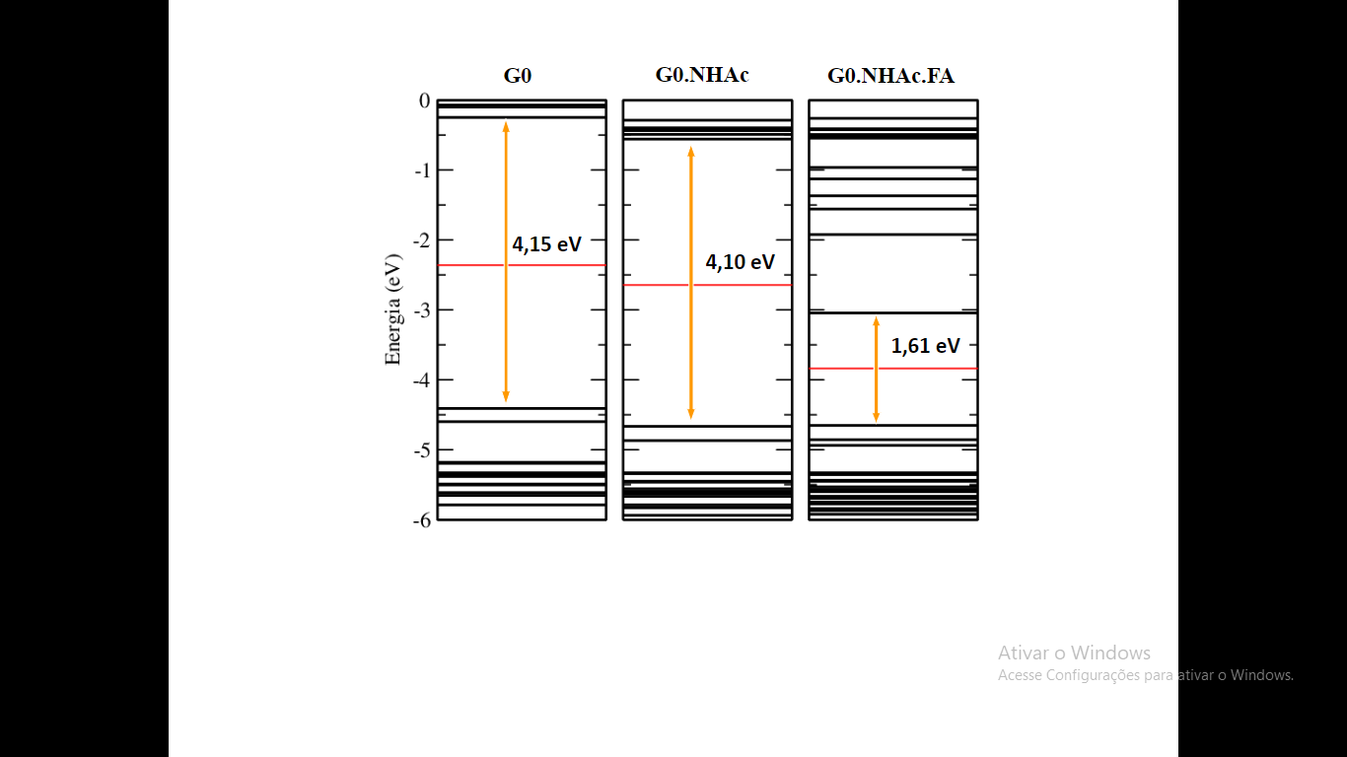
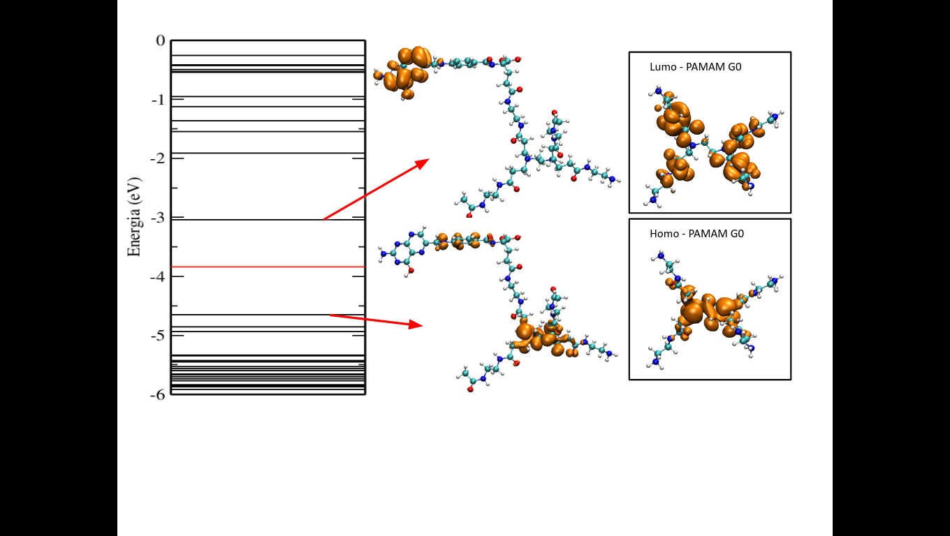
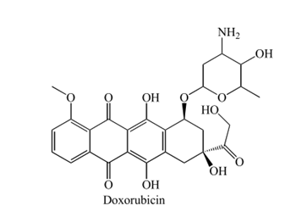
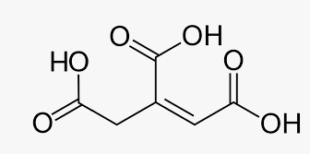


Título do trabalho título do trabalho título do trabalho título do trabalho título do trabalho título do trabalho
Nome Fulano de Tal¹*; Nome Fulano de Tal¹; Nome Fulano de Tal¹
*email@hotmail.com
¹Universidade Tecnológica Federal do Paraná – Campus Toledo
Programa de IC/IT/......
Introduction
One of the methods of cancer treatment is the use of doxorubucin as a chemotherapy drug. Widely used for its effectiveness, it has low specificity and high toxicity, also affecting healthy cells of the body. To minimize side effects, the delivery of doxorubicin by PAMAM dendrimer molecules has been achieved experimentally¹, but the mechanism involved has not yet been demonstrated. In this contribution, the interactions of the nanoparticulate transporter system with potential controlled drug release were studied using the Density Functional Theory, implemented in the SIESTA² code. The delivery system is formed by a PAMAM dendrimer molecule, the drug doxorubicin and two targeting molecules, folic acid and cis-aconitic acid³.
MODELS
TRANSPORT SYSTEM
PAMAM (G0)
Fonte: MAJOROS et al., 2008
Acetyl (NHAc)
Folic acid (FA)
Conclusion
The results showed that the formation of doxorubicin transport systems is favorable, as all the proposed models presented negative formation energies, indicating the formation of stable structures. The models showed similar energy gaps. However, when analyzing the energy levels above the LUMO and below the HOMO, significant differences were observed between the three models. These differences also appear when the charge density of these levels is evaluated. For the G0.NHAc.FA-DOX.CIS structure in model 1, for example, there is a change in the charge density of HOMO when compared to the charge density of G0.NHAc.FA. Changes in the electronic properties confirm that there is an interaction between PAMAM dendrimer structures and doxorubicin for all models studied.
DOXORUBICIN (DOX)
References
Cis-Aconitic acid(CIS)
¹ ZHANG, M., et al. Doxorubicin-Conjugated PAMAM Dendrimers for pH-Responsive Drug Release and Folic Acid-Targeted Cancer Therapy. Pharmaceutics, 10(3), 162, 2018.
² SOLER, J. M., et. al. The SIESTA method for ab initio order-N materials simulation. Journal of Physics: Condensed Matter. 14, 2745, 2002.
³Low, P. S., Henne, W. A., & Doorneweerd, D. D.. Discovery and Development of Folic-Acid-Based Receptor Targeting for Imaging and Therapy of Cancer and Inflammatory Diseases. Accounts of Chemical Research, 41(1), 120–129..

